Slide 1
Integrated Gender Affirmative Hormone Treatment Services Improve Access to and Retention in HIV Testing, Syphilis Testing, and PrEP Service Uptake Among Transgender Women in Thailand
THAC0204
Rena Janamnuaysook, Kritima Samitpol, Pintusorn Ketwongsa, Artsanee Chancham, Jiratchaya Kongkapan, Pravit Mingkwanrungruang, Ratchadaporn Meksena, Panus Rattakitvijunnanakorn, Nuttawut Teachatanawat,
Sutinee Charoenying, Sanya Umasa, Stephen Mills, Ravipa Vannakit,
Praphan Phanuphak, Nittaya Phanuphak
This work was made possible by the generous support of the American people through the United States Agency for International Development (USAID) and the U.S. President’s Emergency Plan for AIDS Relief (PEPFAR). The contents are the responsibility of the LINKAGES project and do not necessarily reflect the views of USAID, PEPFAR, or the United States Government. LINKAGES, a five-year cooperative agreement (AID-OAA-A-14-00045), is led by FHI 360 in partnership with IntraHealth International, Pact, and the University of North Carolina at Chapel Hill.

Slide 2

Outlines
Background
Objective
Methods
Results
Conclusion
Yoshi Rinlada
Miss Tiffany’s Universe 2017

Slide 3
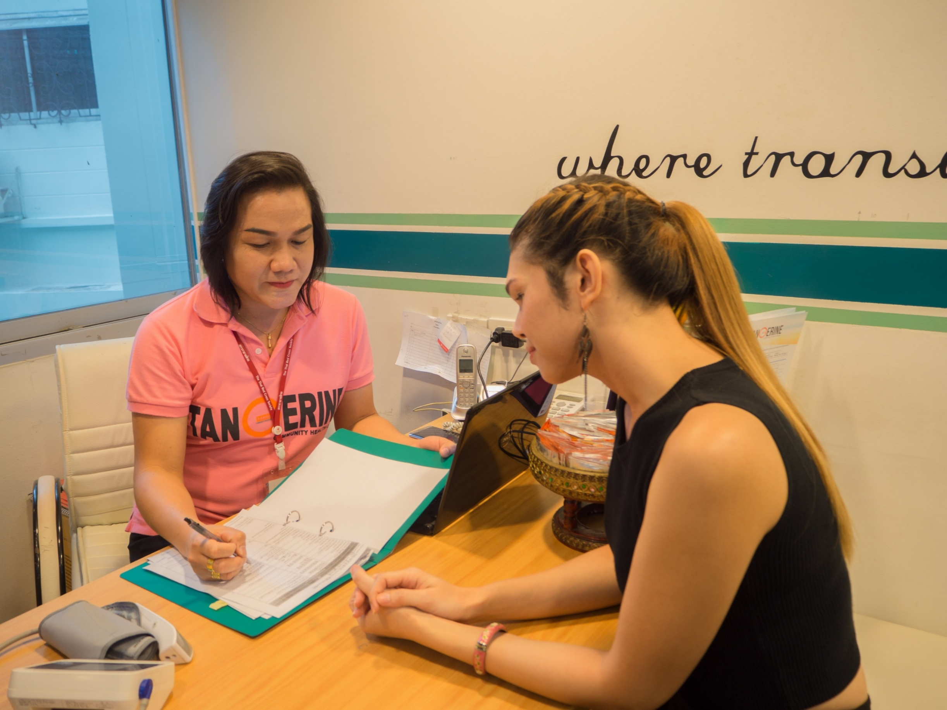
Background
Evidence is limited on the roles of gender affirmative hormone treatment (GAHT) services in HIV programming for transgender women (TGW)

Slide 4
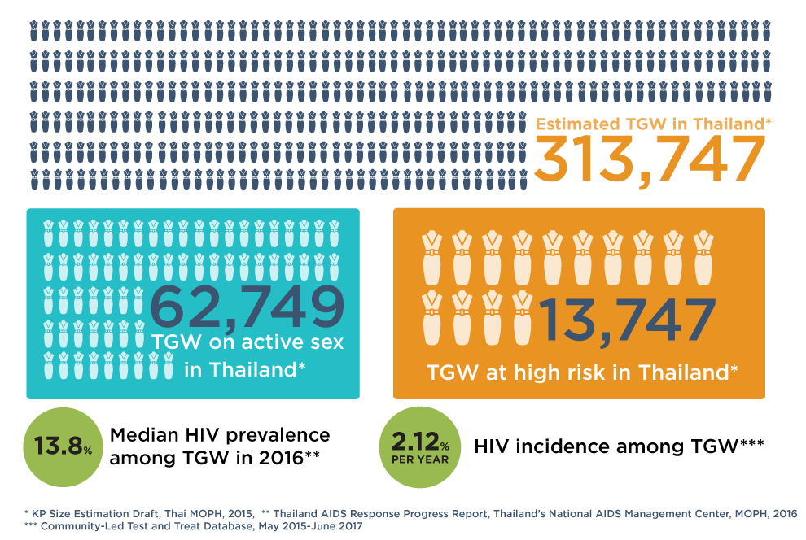
Transgender Women in Thailand:
Population Size Estimation and HIV

Slide 5
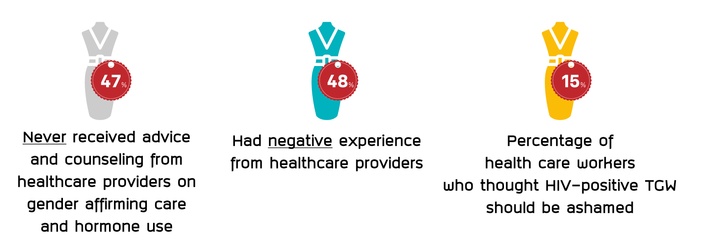
Stigma and Discrimination in Healthcare Settings
**
**
*
Source:
*Thai Transgender Alliance and Transgender Europe, 2015
** Report of a pilot: Developing Tools and Methods to Measure HIV-related Stigma and Discrimination in Health Care Settings in Thailand and;
the HIV Stigma and Discrimination Survey Guidelines and Procedures Manual, International Health Policy Program, National AIDS Management Center (NAMC) Thailand, Ministry of Public Health (November 2014).

Slide 6
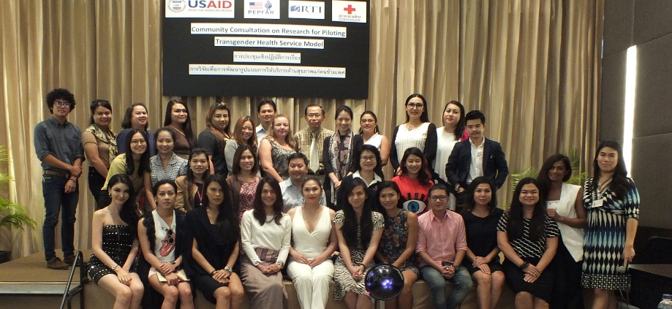
The 1st National Trans Community Consultation
The 1st Transgender Community Consultation
September 17, 2015

Slide 7
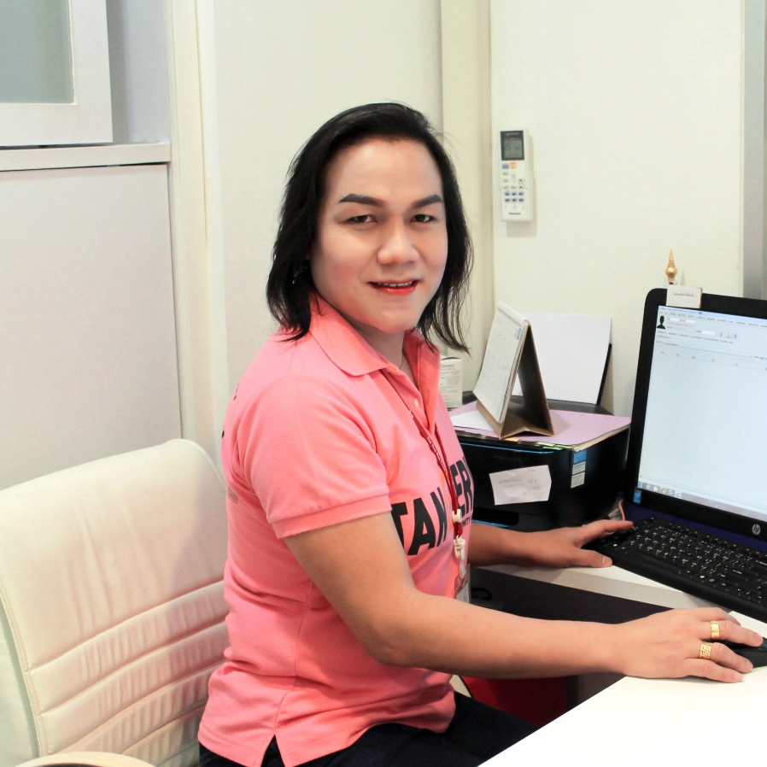


Tangerine Community Health Center
The first trans comprehensive sexual health and well-being clinic in Asia
Founded from a robust trans community consultation with healthcare providers
Led by 4 trained transgender staff, 2 gender-sensitive nurse and physician
Integrated in the public health settings at the Thai Red Cross Anonymous Clinic

Slide 8

Online Outreach Strategies

Slide 9







Slide 10
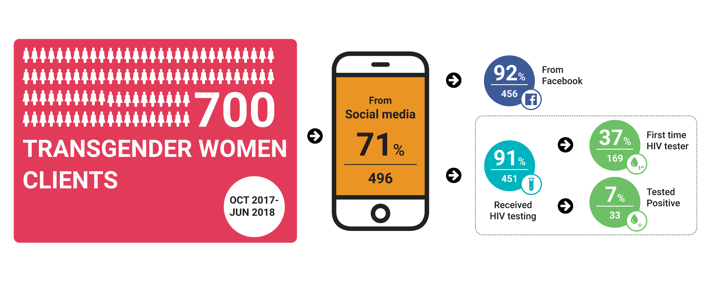
Outreach Performance

Slide 11
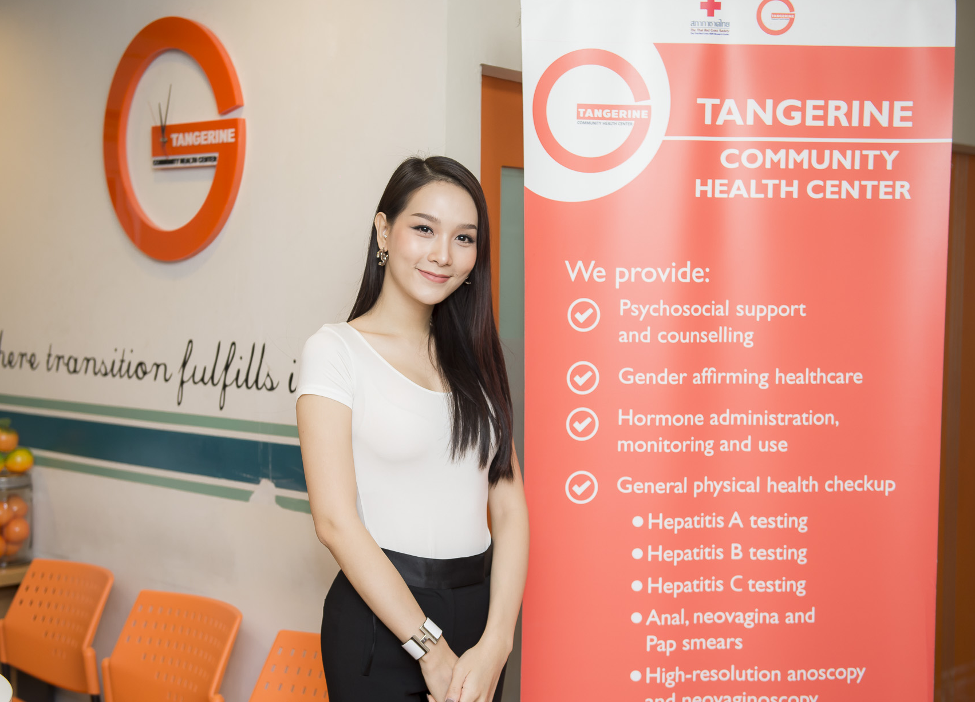
Objective
Examine the potential role of gender affirmative hormone treatment (GAHT) as a service entry point to facilitate the service uptake of
  HIV testing
  Syphilis testing
  Pre-exposure prophylaxis (PrEP)

Slide 12
Methods
Characteristics of transgender women clients and their access to gender affirmative hormone treatment and other health services were assessed
Uptake of HIV and other health services between transgender women who accessed and who did not access gender affirmative hormone treatment services were compared

Slide 13
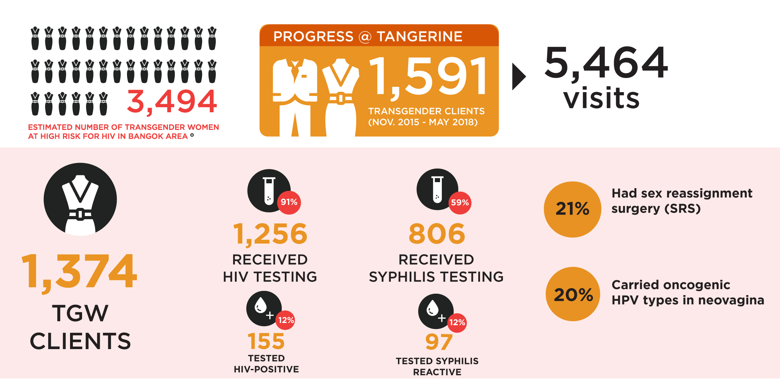
Progress to Date (as of May, 2018)
Notes:
So far Tangerine received 4,500 visits from almost 1,600 transgender clients. Of those, 1,374 were transgender women. 91 per cent received HIV testing and 60% paid for syphilis testing. Tangerine successfully provided HIV testing to one third of trans woman populations at high risk in Bangkok.

Slide 14
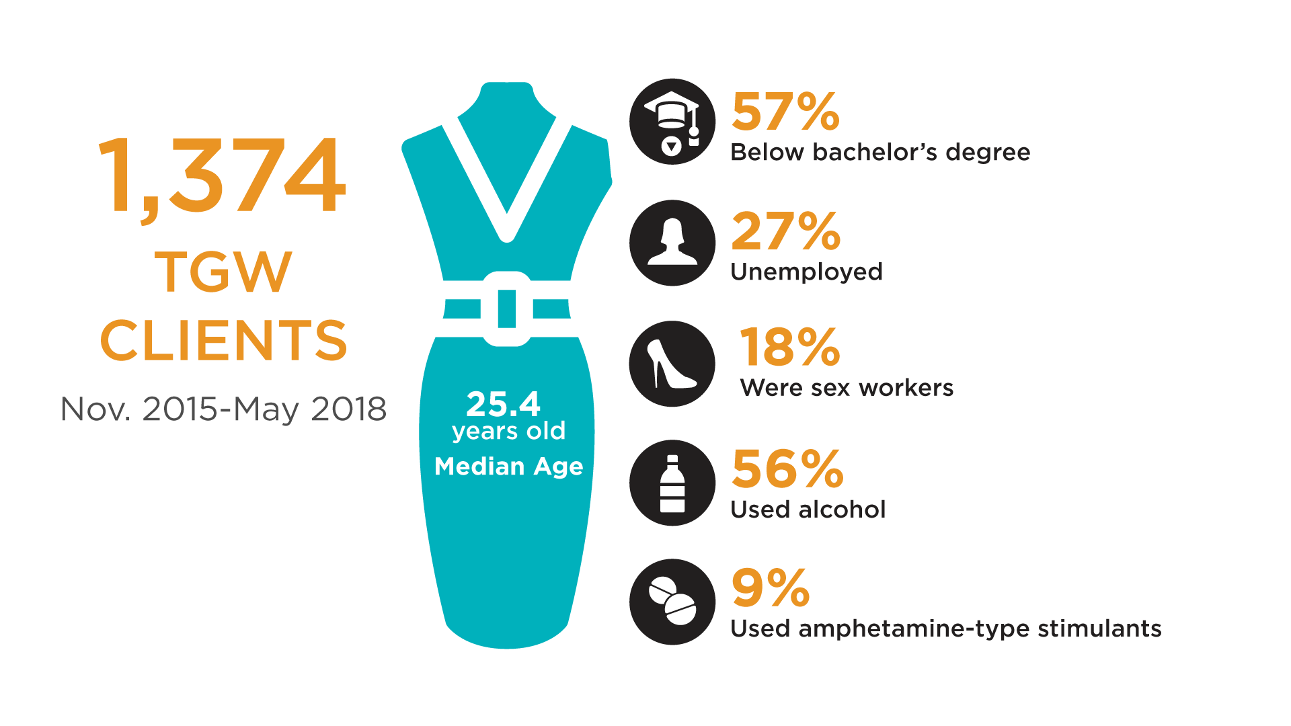
Results

Slide 15
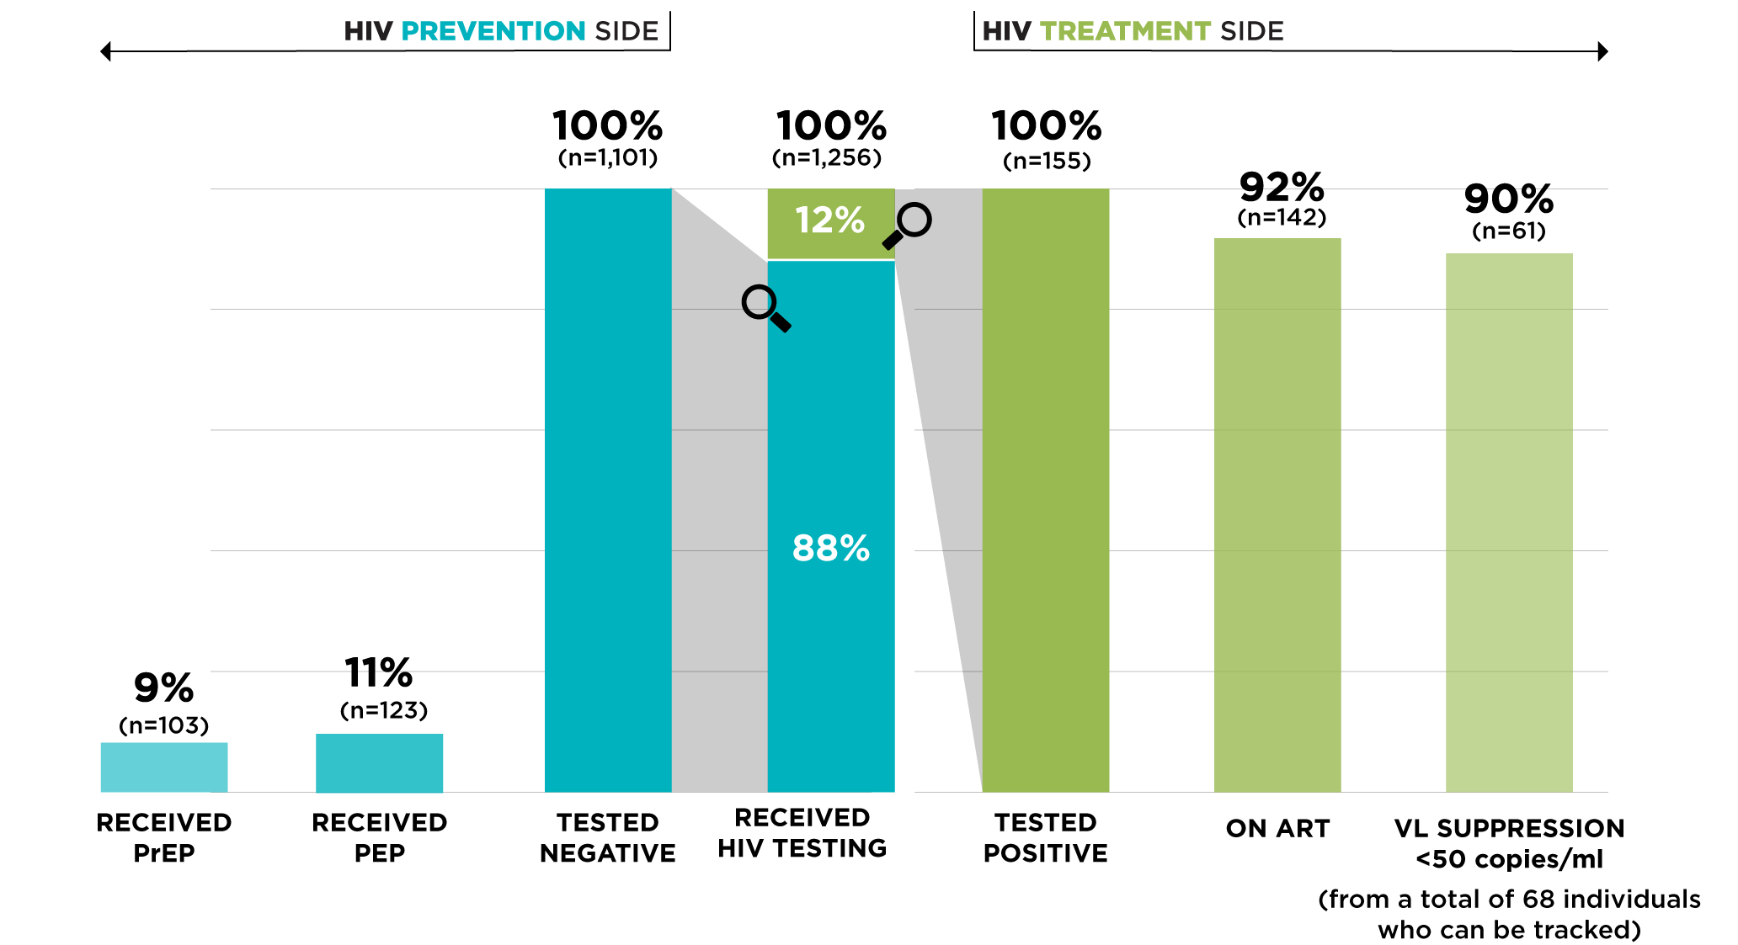
The Double-sided HIV Cascade Performance

Slide 16
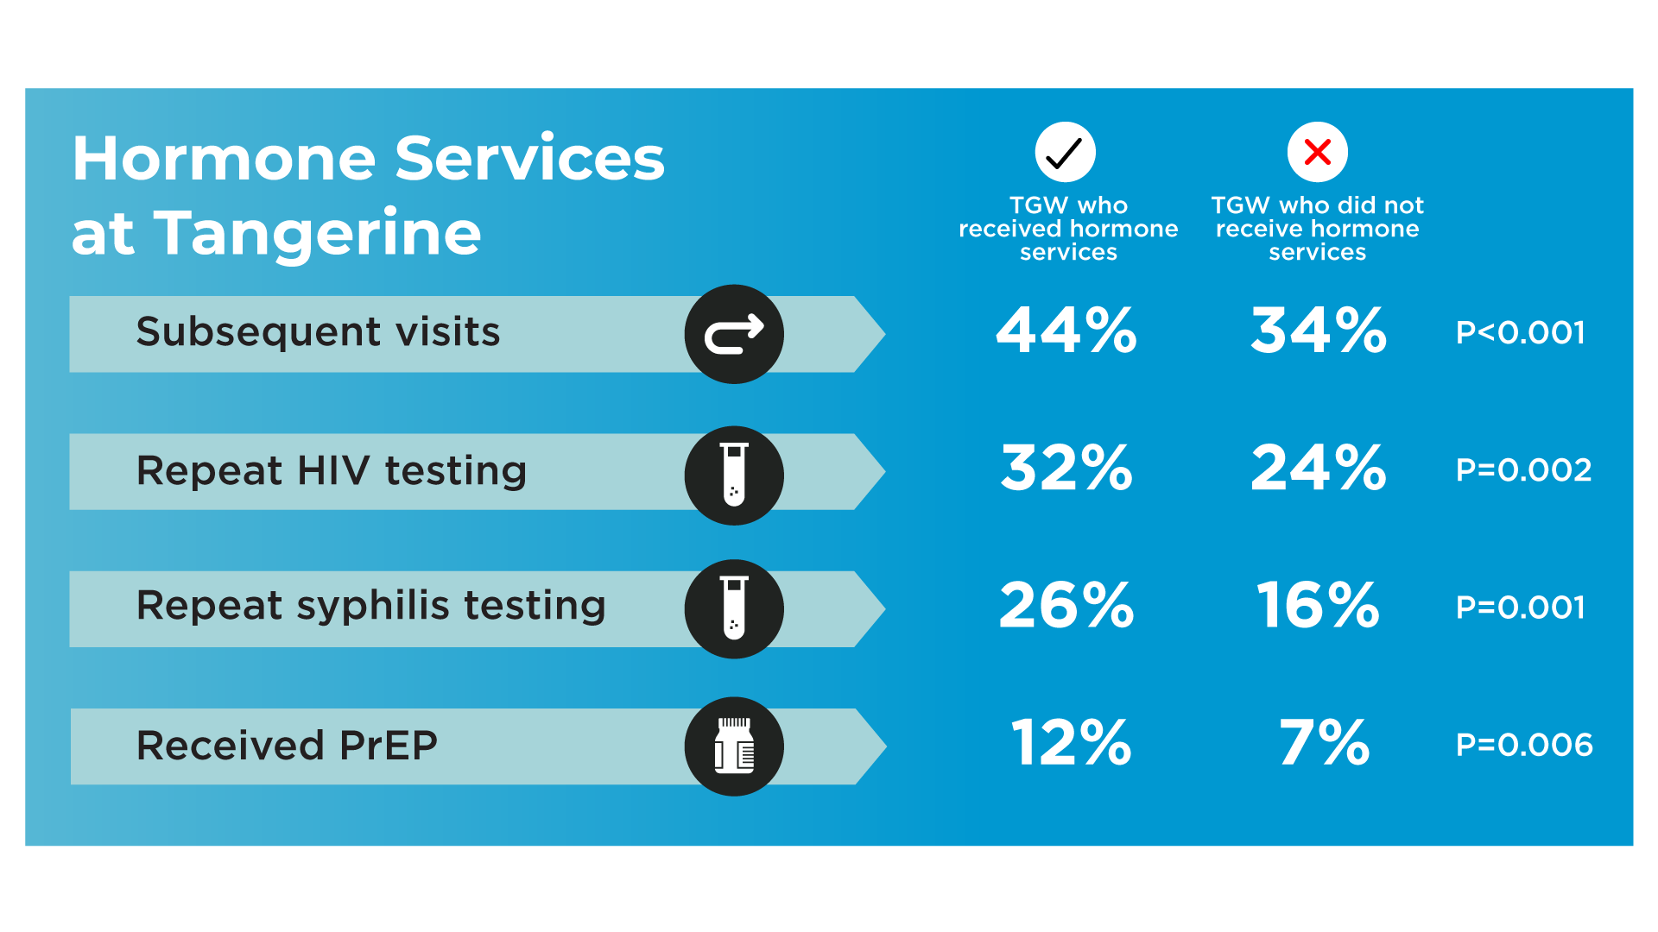
Results: Gender Affirming Hormone Treatment (GAHT)
Increasing HIV Testing, Syphilis Testing and PrEP Uptake

Slide 17
Tangerine Story: Survivor from sexual abuse
Young trans woman, aged 14, visited Tangerine with her mother
Learned Tangerine from a trans icon through social media
Hormone was her primary purpose
Sexually abused by a school senior
Accepted HIV testing offered by a trans counselor
Tested HIV-positive and successfully initiated same-day ART
Referred to HIV pediatrician
Mother supporting her gender transition and treatment adherence

Slide 18
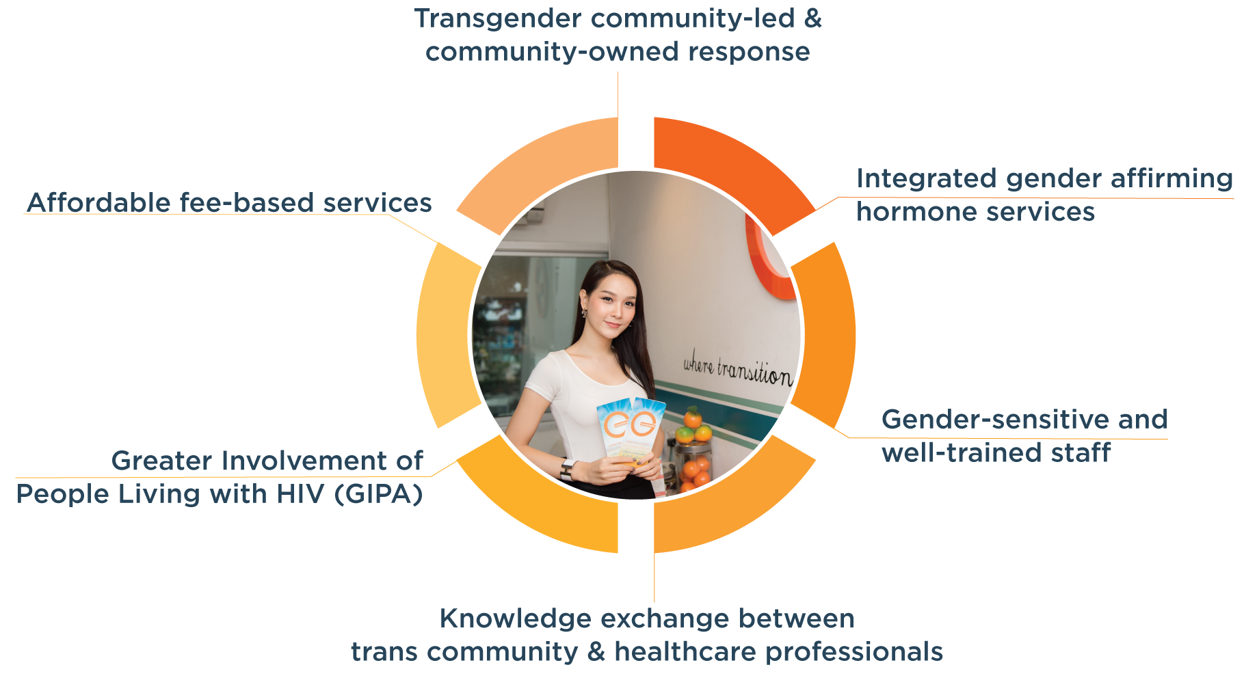
Conclusions

Slide 19
Acknowledgements
Professor Emeritus Dr. Praphan Phanuphak
Dr. Nittaya Phanuphak
Dr. Frits van Griensven
TANGERINE and PREVENTION Staff
U.S. President’s Emergency Plan for AIDS Relief (PEPFAR)
United States Agency for International Development (USAID) Regional Development Mission for Asia (RDMA)
LINKAGES Thailand/ FHI 360
Thai Transgender Communities

